Slide 1
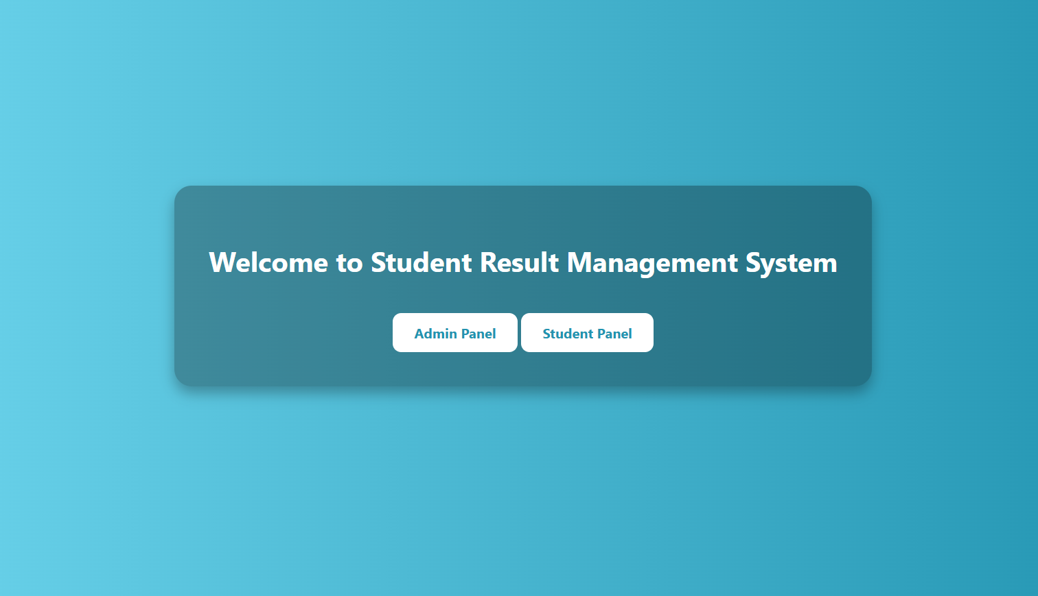
Student Result Management System
An overview of admin and student functionalities.
By Hitesh Kumar (24mca20256)
https://github.com/hitteshkharyal/student_result_management_system.git

Slide 2

Introduction
This presentation explores the features of the Student Result System, focusing on both the admin and student views.

Slide 3
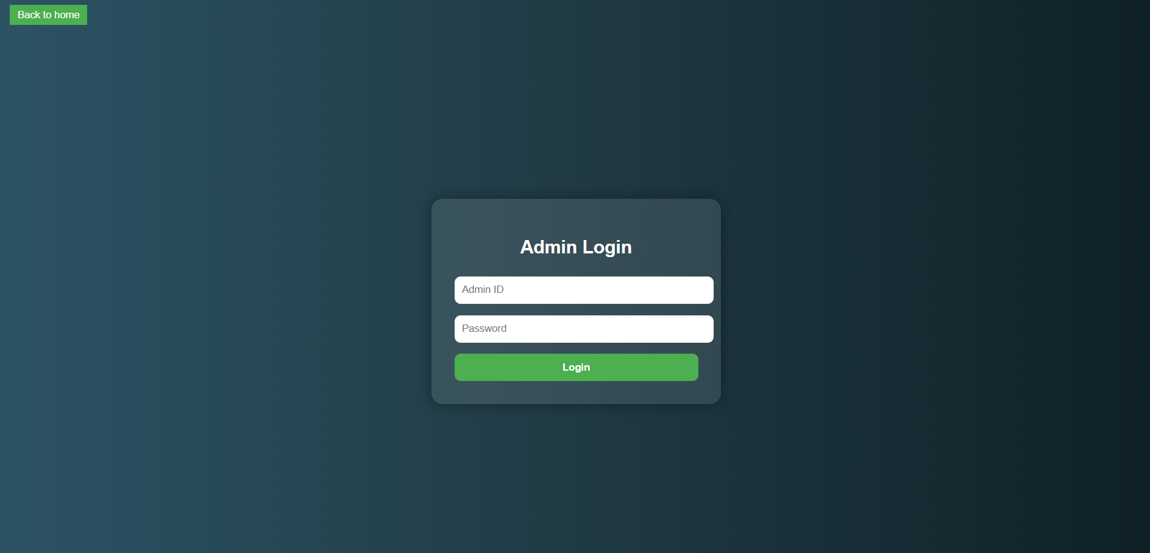
01
Admin View

Slide 4
Admin Login Process
The admin login process involves secure authentication to access the system. Admins are required to enter their credentials, which typically include a username and password. Once logged in, the admin can perform various tasks related to student records and marks.

Slide 5
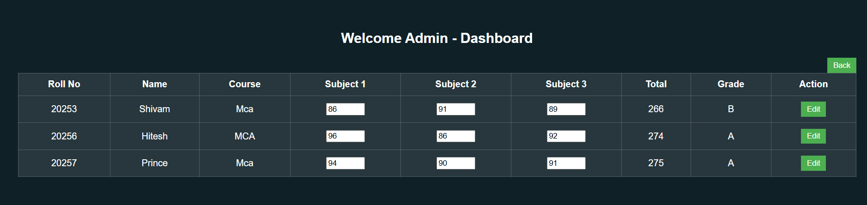
Adding Student Marks
Admins can add marks for students through a dedicated section of the system. This process usually includes selecting the student from a list, entering the relevant marks for various subjects, and saving these entries. The admin must ensure data accuracy and integrity during this process.

Slide 6

Managing Student Records
Admins have tools to manage student records efficiently. This includes viewing, editing, and deleting student information. They can maintain up-to-date records by ensuring all student details are current, including names, contact information, and academic performance. Proper management helps in generating reports and communicating with students and parents.

Slide 7
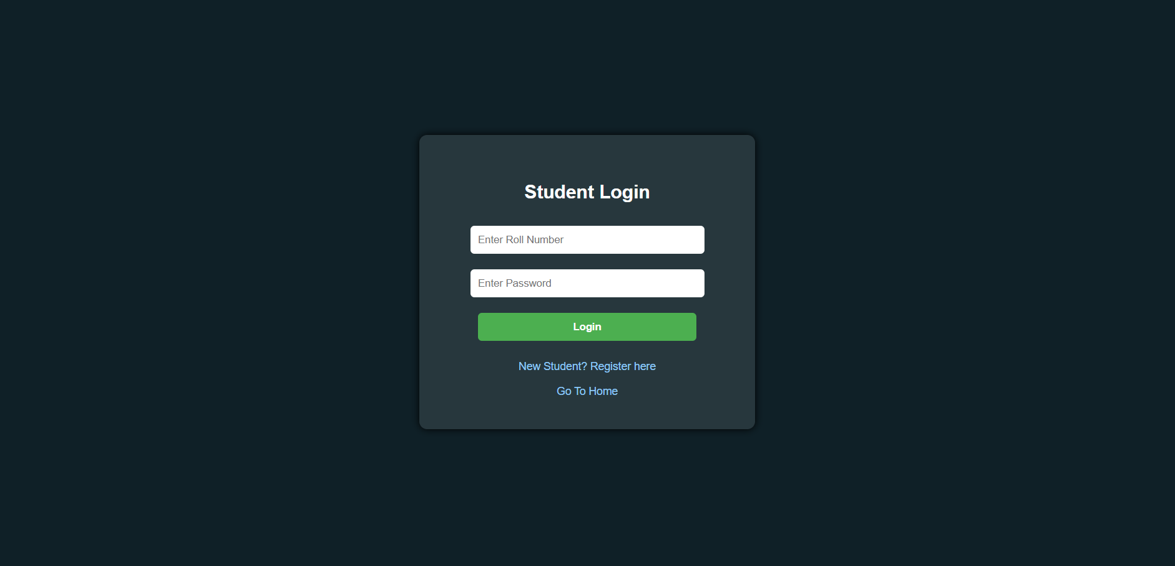
02
Student View

Slide 8
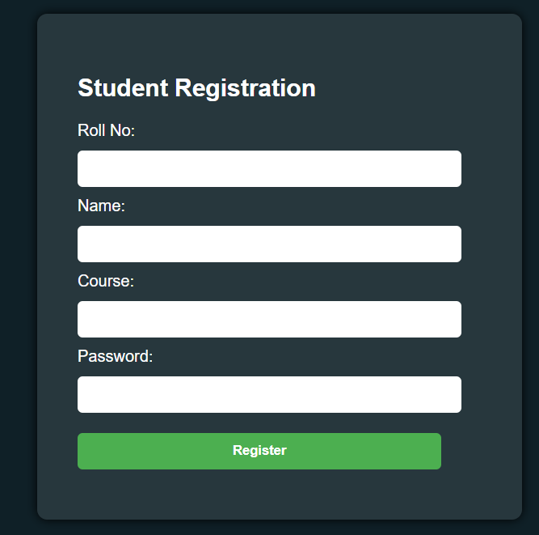
Student Registration Process
The student registration process allows new students to set up an account in the system. Students are required to provide personal details such as name, email address, and other relevant information. After submitting their information, they may need to verify their email to activate their account.

Slide 9
Student Login Process
Once registered, students can log in to the system using their credentials. This typically involves entering a username and password. Security measures, such as password recovery options, ensure that students can regain access if they forget their login details.

Slide 10
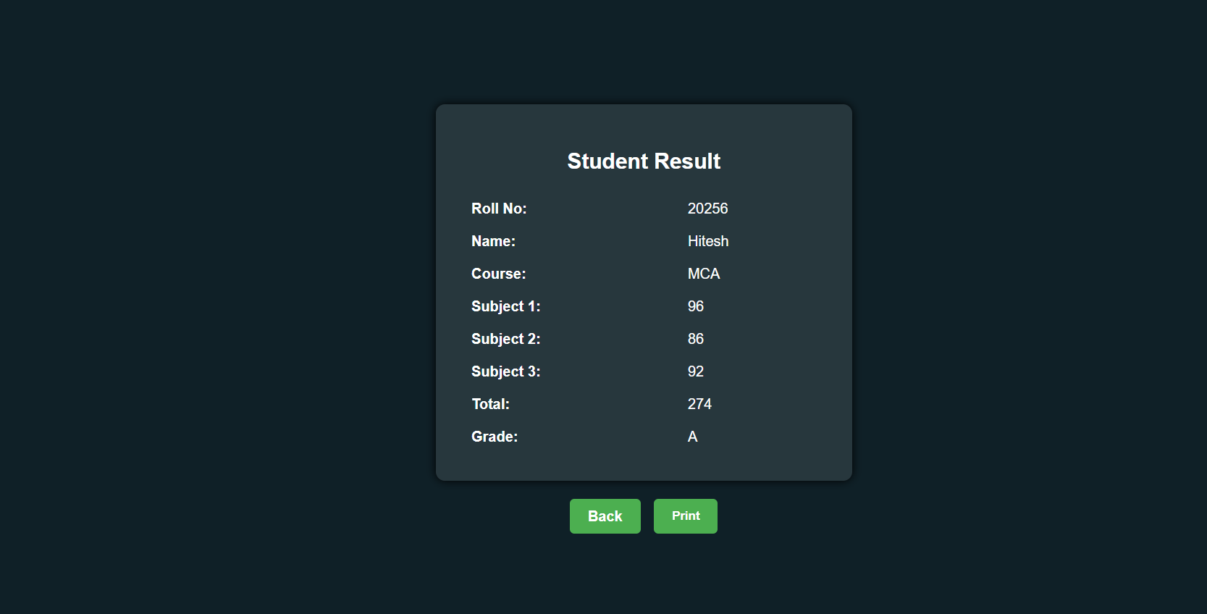
Viewing Result
After logging in, students can view their result on their dashboard. The roll number serves as a unique identifier for each student within the system, used for tracking academic records and results. This feature allows students to keep track of their academic progress effectively.

Slide 11

Conclusions
In summary, the Student Result System provides essential functionalities for both admins and students. Admins can manage student records and marks efficiently, while students can register, log in, and access important information like their result. This system enhances communication and transparency in academic tracking.

